Slide 1
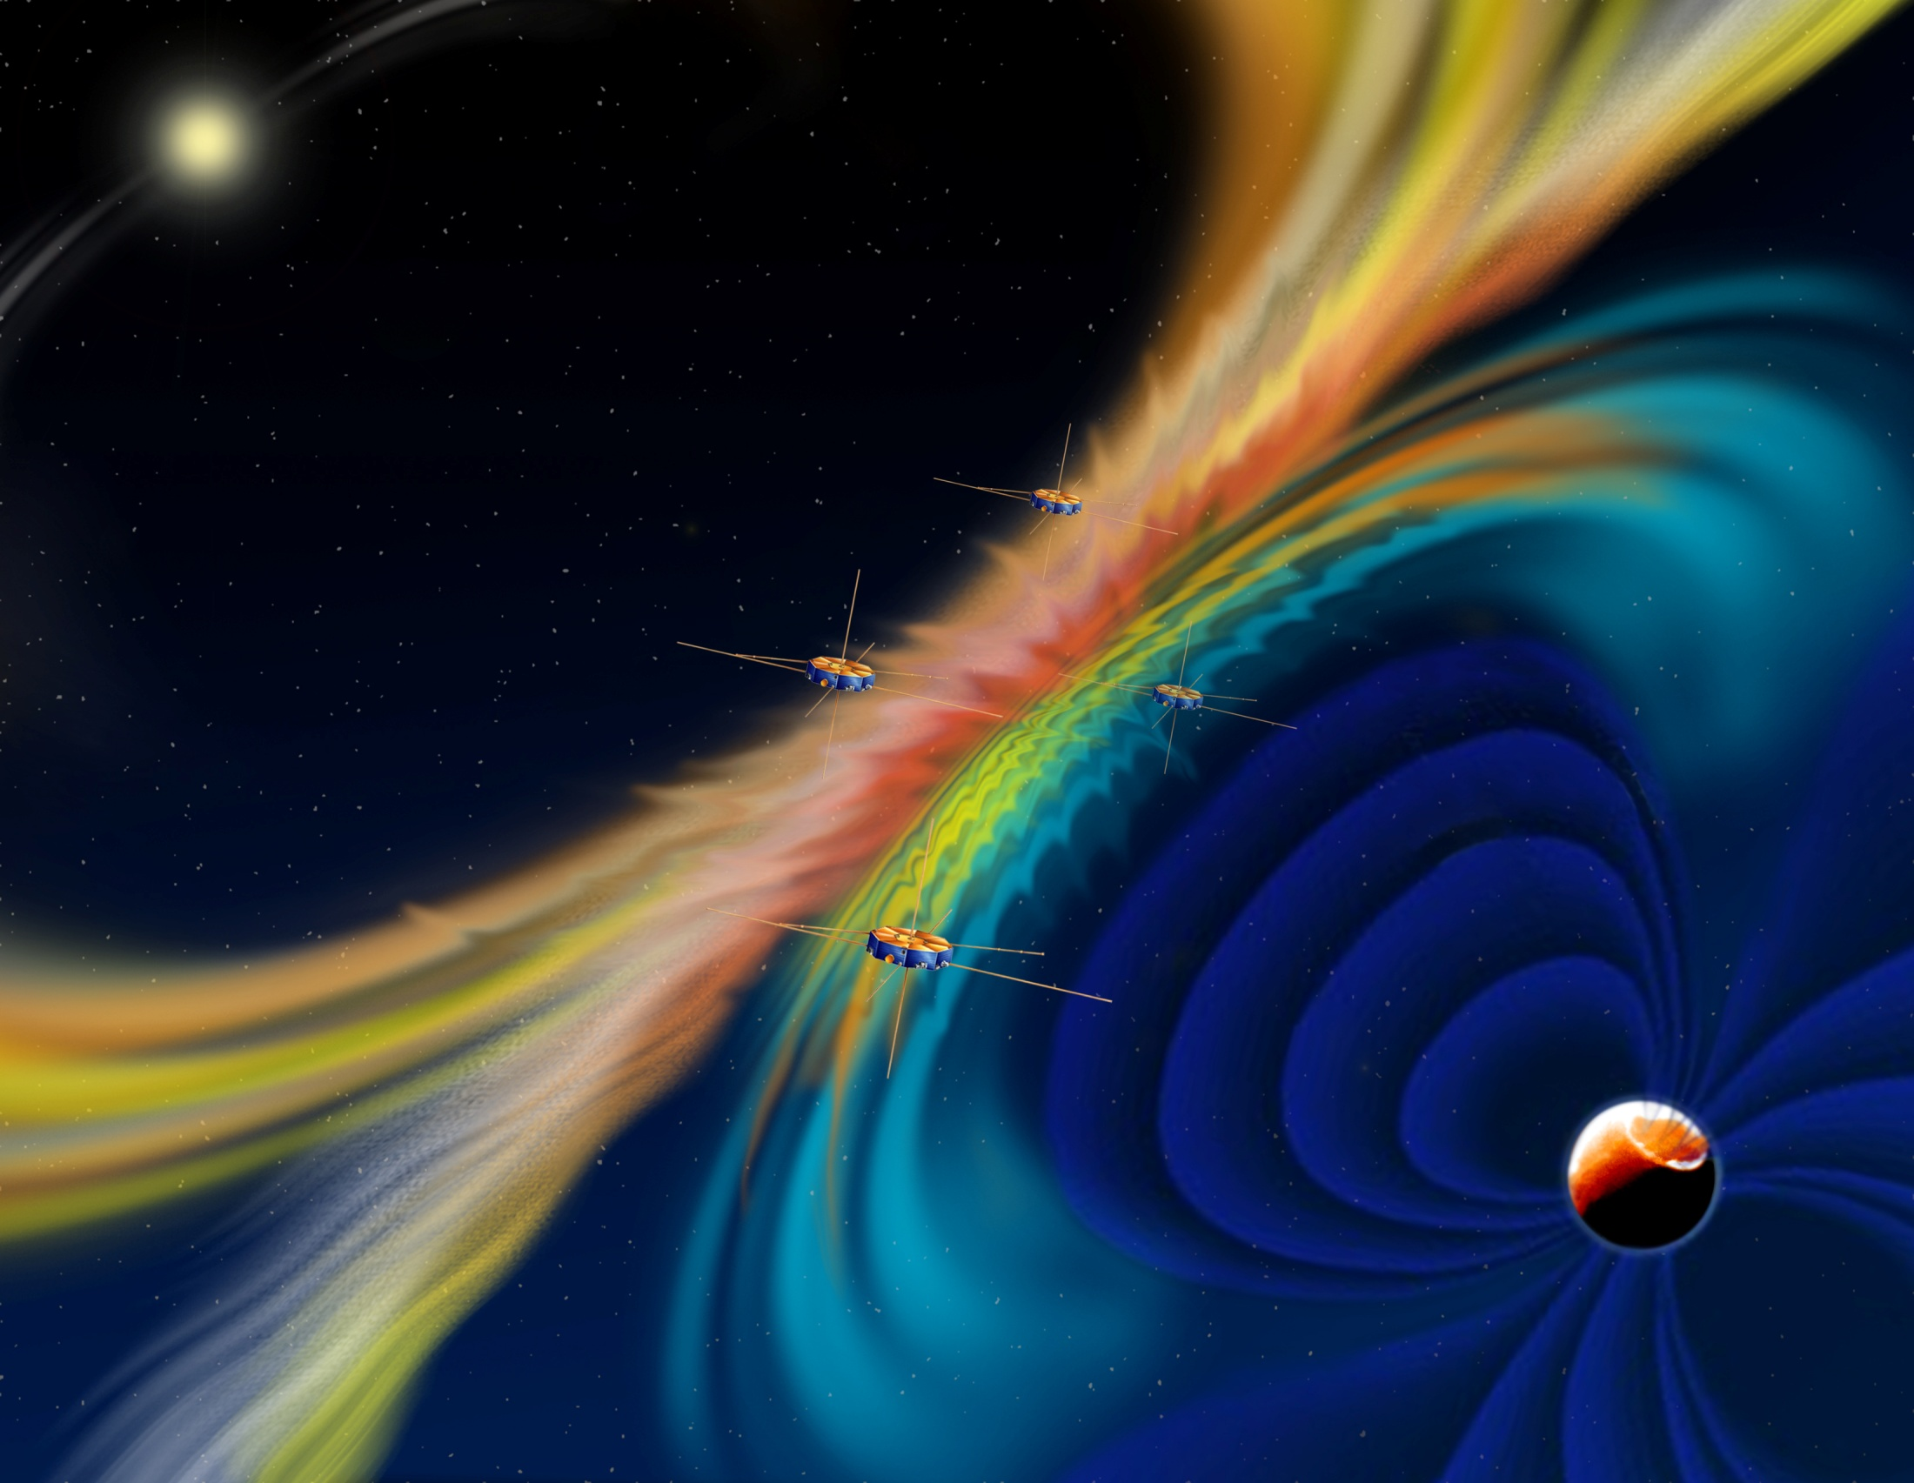
In preparation to the MMS science
Yuri Khotyaintsev
IRF-U

Slide 2
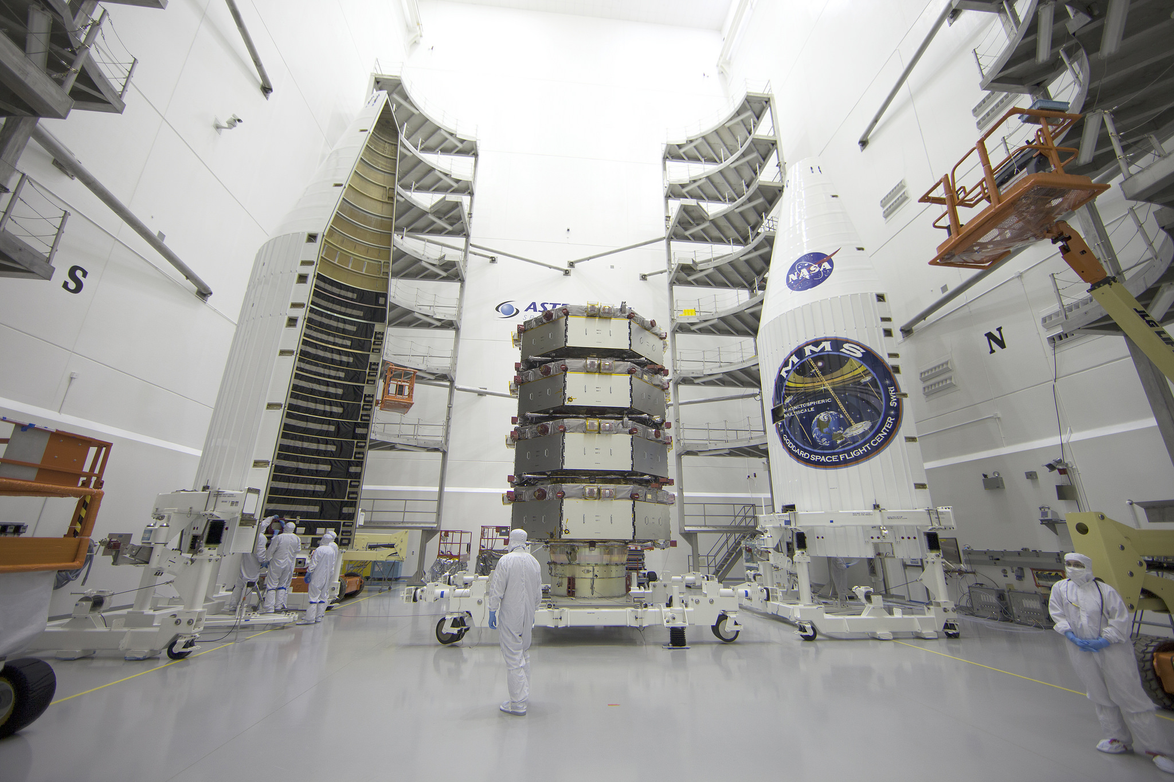
Atlas V + Centaur

Slide 3
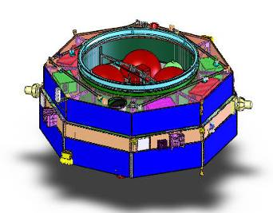
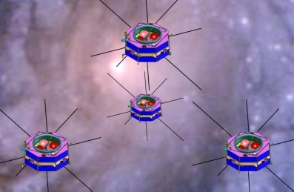
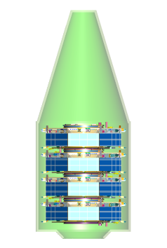
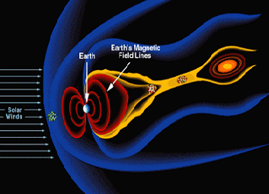
Magnetospheric MultiScale (MMS)
Science Objectives
Discover the fundamental plasma physics process of reconnection in the Earth’s magnetosphere
Temporal scales of milliseconds to seconds
Spatial scales of 10s to 100s of km
Mission Description
4 identical satellites
Formation flying in a tetrahedron with
separations as close as 10 km
2 year operational mission
Orbit
Elliptical Earth orbits in 2 phases
Phase 1 day side of magnetic field 1.2 R_{E} by 12 R_{E}
Phase 2 night side of magnetic field 1.2 R_{E} by 25 R_{E}
Significant orbit adjust and formation maintenance
Instruments
Identical in situ instruments on each satellite measure
Electric and magnetic fields
Fast plasma with composition
Energetic particles
Hot plasma composition
Four Gbits/day/spacecraft
Spacecraft
Spin stabilized at 3 RPM
Magnetic and electrostatic cleanliness
Launch Vehicle
4 satellites launched together in one Atlas V
Mission Status
Launch on March 12, 2015
_{Earth Magnetic}
_{Field Lines}
_{Earth}
_{Earth}
_{Solar}
_{Wind}
Mission Team
NASA SMD
Southwest Research Inst
Science Leadership
Instrument Suite
UNH,GSFC,LASP,APL,KTH,IRFU,LPP,IWF
JAXA,UCLA,UIowa,MSFC,Oulu,Aerospace Corp
Science Operations Center
Science Data Analysis
NASA GSFC
Project Management and System Eng
Mission System Engineering
Spacecraft and Mission Operations Center
Notes:
3

Slide 4
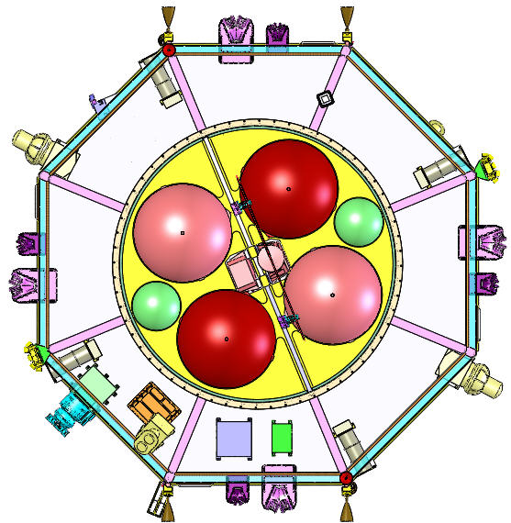
Instrument Suite
FIELDS - Electric and magnetic (E,B) measurements at >1 ms timing resolution
Fast Plasma - Image full sky at 32 energies: electrons in 30 ms, ions in 150 ms. ( n, Ui, Ue, P, fe, fi)
Energetic Particles - All-sky viewing of ion and electron energetic particles (20 – 500 keV) using 2 sensor types (fe, fi)
HPCA - Measures the composition resolved 3D ion energy distributions (fi) for H+, He++, He+, and O+
ASPOC – Maintains s/c potential to <= 4 V. Enables valid (fi, E, B) data
CIDP – Power distribution and manages command and data flow – burst data memory management
FPI-DIS
FPI-DES
SDP
INSTRUMENT DECK
EIS
ASPOC
EDI-GDU
SDP
FEEPS
FPI-DIS
FPI-DES
FPI-DIS
FPI-DES
FEEPS
EDI-GDU
SDP
HPCA
CIDP
ASPOC
SDP
CEB
FPI-DES
FPI-DES
IDPU CD-H
Notes:
4

Slide 5
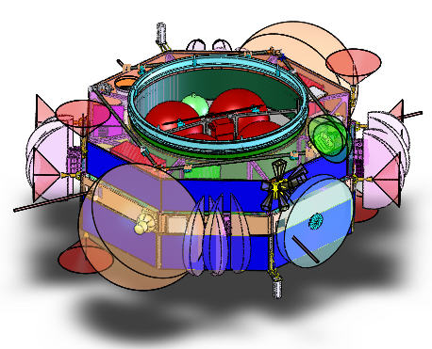
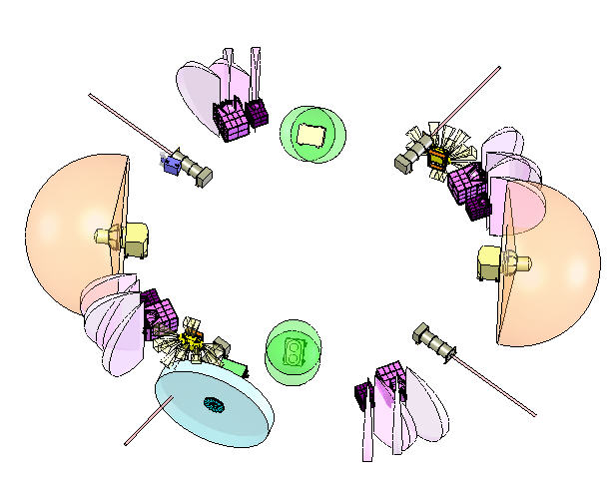
FPI Hardware Overview
4 Dual Electron Sensors (DES)
8 apertures
4 Dual Ion Sensors (DIS)
8 apertures
180˚ x ~10˚ fields of view, steerable in s/c azimuth ± 18˚
Central IDPU processes commands and flows data to CIDP
30 ms 3D electron distributions
FPI is distributed around each MMS spacecraft for instantaneous all-sky viewing.
Notes:
5
Put the block diagram on a slide by itself later on

Slide 6
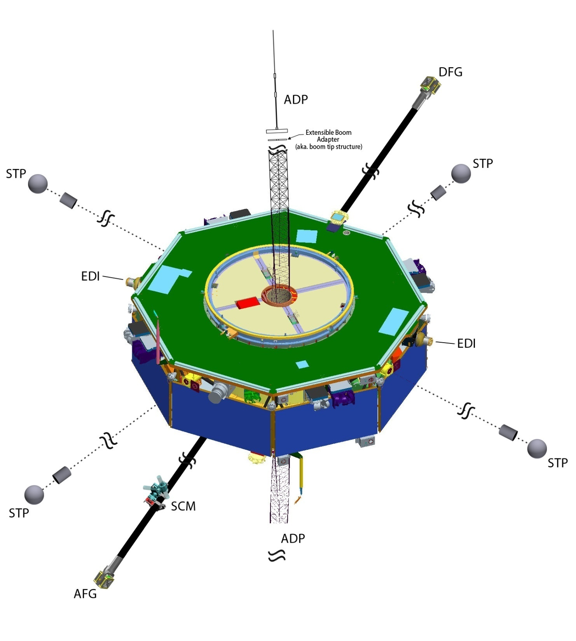
FIELDS Sensors on MMS
SDP
SDP
+Higher data rates
+ADP longest ever, 31.5m
+SDP 120m
+FGM part of FIELDS
+EDI new energy 250keV
- Smaller SCM
- No WHISPER
SDP
SDP
Notes:
6
Higher data rates
ADP – longest ever
FGM part of FIELDS
EDI – new energy – 250 keV (compared to Cluster)

Slide 7
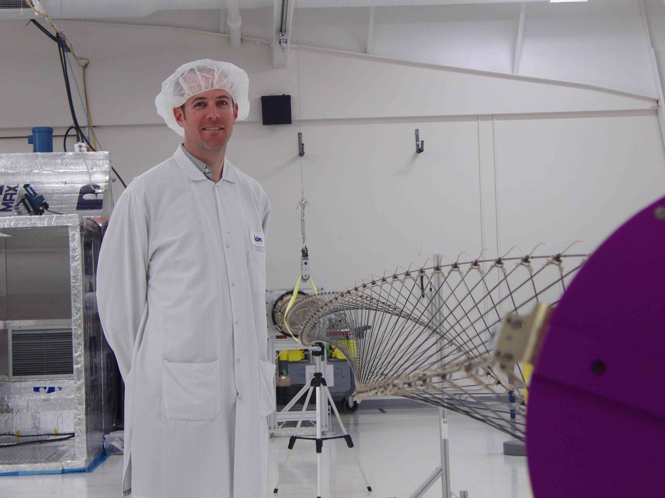

Slide 8
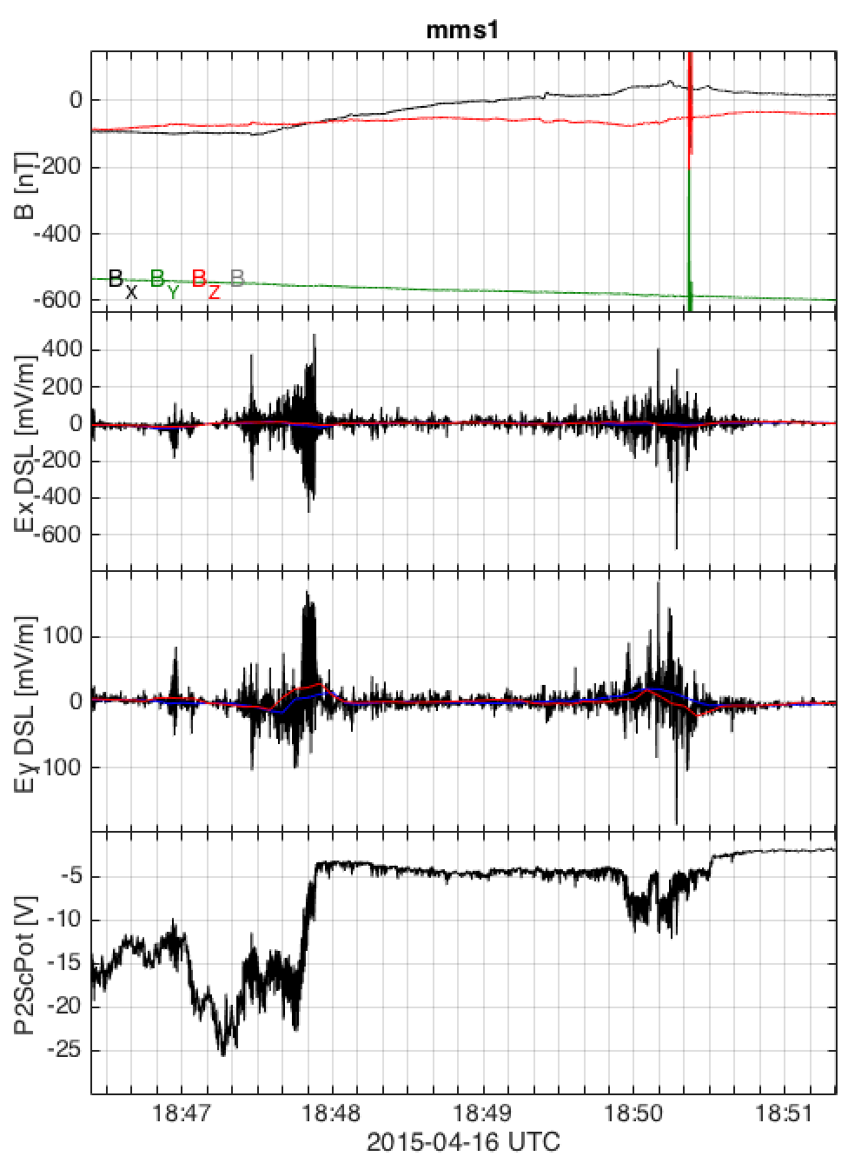
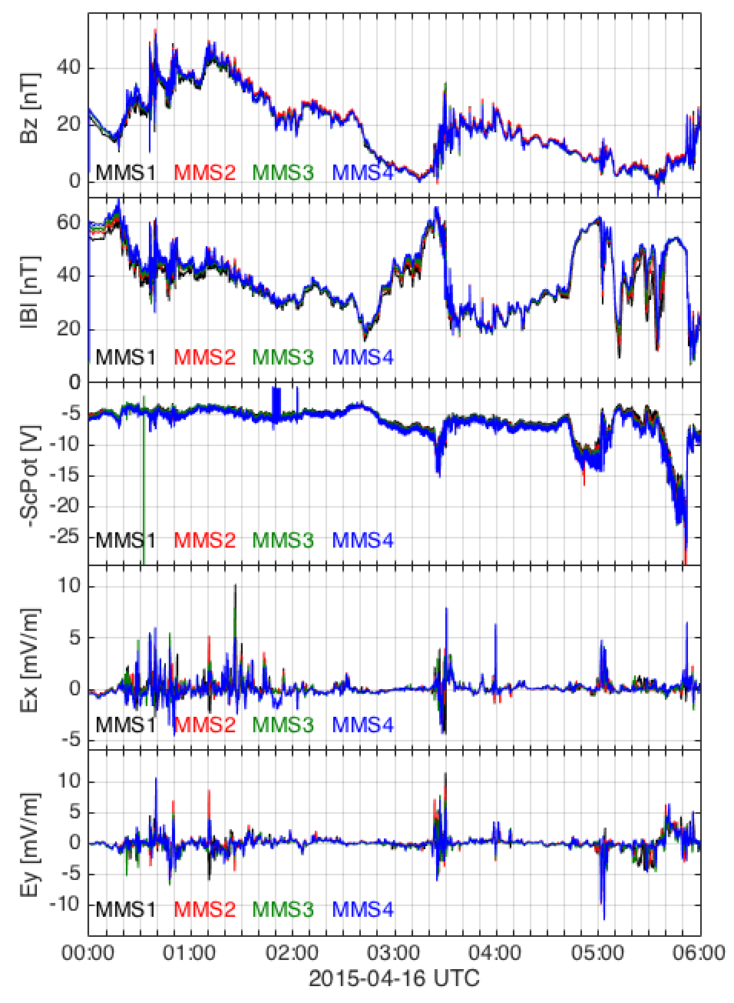
FIELDS Commissioning
Tail, X=-10 RE
Auroral zone, R=5 RE

Slide 9
MMS science: Unlocking the Secrets of the Electron Diffusion Region
The overarching goal of the MMS mission is to measure the plasma and the electric and magnetic fields inside the diffusion regions of Earth’s magnetosphere in order to answer the following fundamental open questions:
What determines when reconnection starts and how fast it proceeds?
What is the structure of the diffusion region?
How do the plasmas and magnetic fields disconnect and reconnect in the diffusion regions?
What role do the electrons play in facilitating reconnection?
What is the role of turbulence in the reconnection process?
How does reconnection lead to the acceleration of particles to high energies?

Slide 10
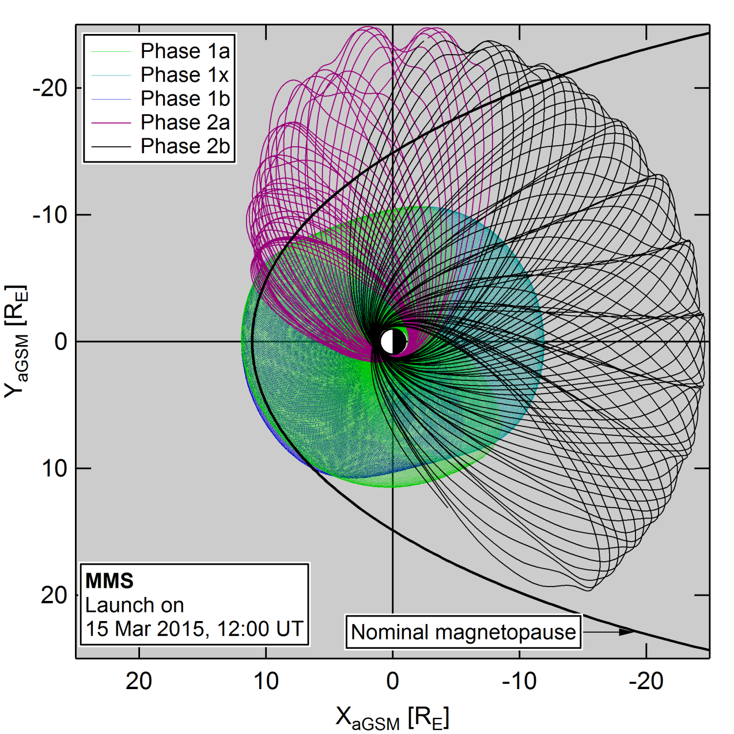
Mission phases
Phase 1: 12Re apogee
1a: Dec 2015, subsolar MP
1x: Jun 2016, near-Earth tail
1b: Jan 2017, subsolar MP
2a: Apr 2017 – apogee rise
Phase 2: 25Re apogee
2b : Jul 2017, tail

Slide 11
FY16: THM/ART-MMS-VAP coordination: THM-MMS are period-locked, at same mean anomaly
MMS, THM at Dawn or Dusk opposite each other (Mar. and Sep., 2016) Coordinated L-shell crossings determine particle sources and wave contribution to inner m’sphere particle flux growth/decay
MMS Tail #1 (THM at dayside) (MMS Phase 1x, Jun. 29, 2016) THM studies dayside Rx; MMS at the plasma sheet boundary studies flux transport (using EDI instrument); connects to VAP
MMS Dayside #1 (THM in Tail) (MMS Phase 1a, Dec. 16, 2015) THM detects tail bursts, connects injections to VAP
6
6
6
A
P5
P1
12
B
P3
12
12
P4
P2
MMS
THM
ARTEMIS @ 55R_{E} when in the solar wind measures with high fidelity the energy input.
ARTEMIS @ 55R_{E} accurately measures global energy storage and release
18
18
18
CL
^{(out of equator)}
THM-MMS resonances: P3,4:MMS = 1:1 [P3,4 R_{A}=12.1R_{E}]
P5:MMS = 8:7 [P5 R_{A}=13.2R_{E}] (except in Phase1a where P5 is as P3,4)
At all times at least two THEMIS spacecraft are in-phase w/MMS
P5 scans all separations (lap period = 8 days) and is a link to VAP
GT

Slide 12
FY17: coordination with MMS in Phase 1b as in FY16; in MMS Phase 2b, THM is MMS-resonant.
MMS Dayside #2 (THM in Tail) (MMS Phase 1b, Jan. 12, 2017) THM detects Rx fronts, electron injections, links to VAP’s waves
MMS, THM at Dawn and Dusk respectively (Apr. 19, 2017). MMS in ascend phase (1x) L-shell crossings determine particle sources and wave contribution to inner m’sphere particle flux growth/decay
MMS Tail #2 (THM at dayside) (MMS Phase 2b, Jul. 22, 2017) THM and MMS study dayside and nightside Rx simultaneously; VAP determines geoeffectiveness
6
6
6
A
P5
B
P1
P3
P2
P4
MMS
THM
ART @55R_{E}
ART @55R_{E}
18
18
18
THM-MMS period resonances during Phase 2b: P5:MMS = 5:2 [P5 R_{A}=13.2R_{E}] (For every 5 orbits of P5, MMS has 2)
P3:MMS = 6:2 [P3 R_{A}=11.5R_{E}]
P4:MMS = 11:4 [P4 R_{A}=12.3R_{E}]
Every 2 MMS orbits P3 and P5 are at apogee while MMS is too Every 4 MMS orbits all 3 THEMIS spacecraft are at apogee At all times at least one THEMIS spacecraft is near m’pause

Slide 13
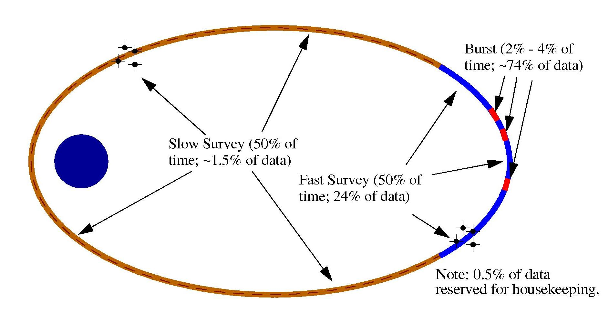
Burst Memory Management Overview
Basic Plan: Obtain ~20 minutes of burst per day.
Phase 1 orbit: ~1 day -> 20 min. burst data.
Phase 2 orbit: ~3 days -> 1 hour of burst data.

Slide 14
Burst Data Selection
Automatic Selection (SOC)
Buffer
Selection
Command
Generation
Weight
Tables
Burst
Metadata
(CDQs)
Calculate
MDQ
Calculate
FOM
SITL Selection
Trigger
Data
Survey
Data
View Data
Select Intervals
Calculate
FOM
SITL
Tables
SITL
Auto
Process Survey
And Trigger Data
Calculate
FOM
SITL – scientist in the loop
Notes:
14

Slide 15
Science Data
MMS-SMART scientifically useful data products are open to all scientists and the public (Users).
There are no proprietary periods associated with any of the MMS-SMART data products.
Users shall have timely access to the scientifically useful data and analysis tools that are equivalent to the level that the MMS-SMART science team uses.
All potential data users are strongly encouraged to contact the MMS-SMART Principal Investigator (PI) or a designated lead investigator of an instrument or modeling group early in an analysis project to discuss the appropriate use of instrument data or model results.
All users who wish to publish results derived from MMS data are strongly encouraged to directly involve the MMS-SMART PI and/or Instrument Leads and team members as appropriate in the analysis and to offer co-authorship. Data users who are members of the MMS-SMART science team are required to offer co-authorship. Co-authorship may be declined.
Users should heed the caveats of investigators as to the interpretation and limitations of data or model results. All important caveats should be included in the publication, even if co-authorship is declined. Data and model version numbers should also be specified.
Users should acknowledge the sources of data used in all publications, presentations, and reports. Appropriate acknowledgement to institutions, personnel, and funding agencies should be given.
Users are encouraged to provide the MMS-SMART PI and/or instrument PIs a copy of each manuscript that uses MMS-SMART data upon submission of that manuscript for consideration of publication. On publication the citation should be transmitted to the PI and any other providers of data.
MMS encourages that pre-prints of publications and conference abstracts be widely distributed to interested parties within the mission and related projects.
Users are encouraged to make tools of general utility and/or value-added data products widely available to the community. Users are encouraged to notify the MMS-SMART PI of such utilities or products. The User should also clearly label the product as being different from the original MMS-SMART produced data product.
All fully calibrated data (CAA style) available 30 days after ground receipt*.
*Valid 6 month after start of nominal operations, i.e. 10 month after launch.

Slide 16
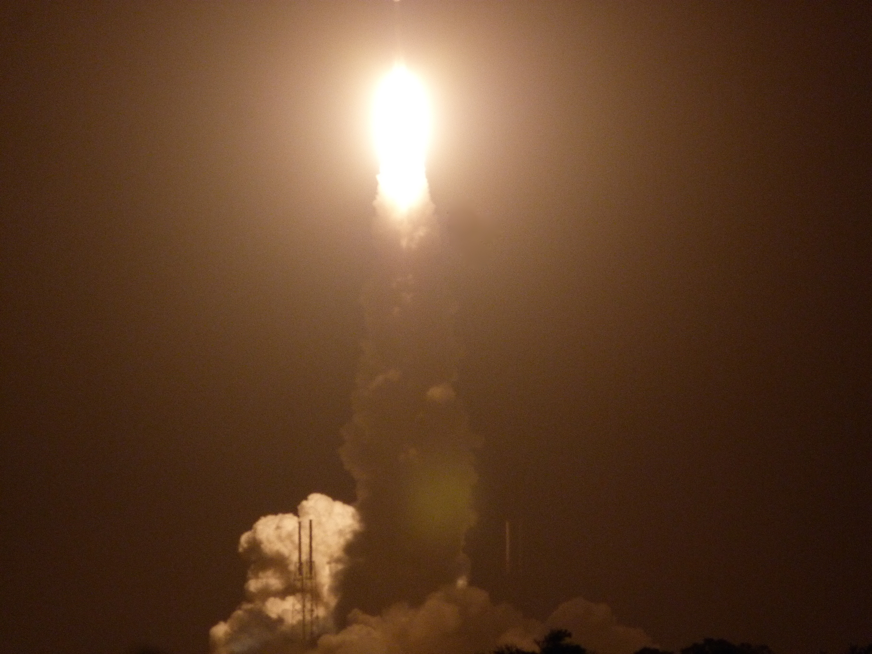
Conclusions:
- Commissioning progressing well
- Nominal operations start in September 2015

Slide 17
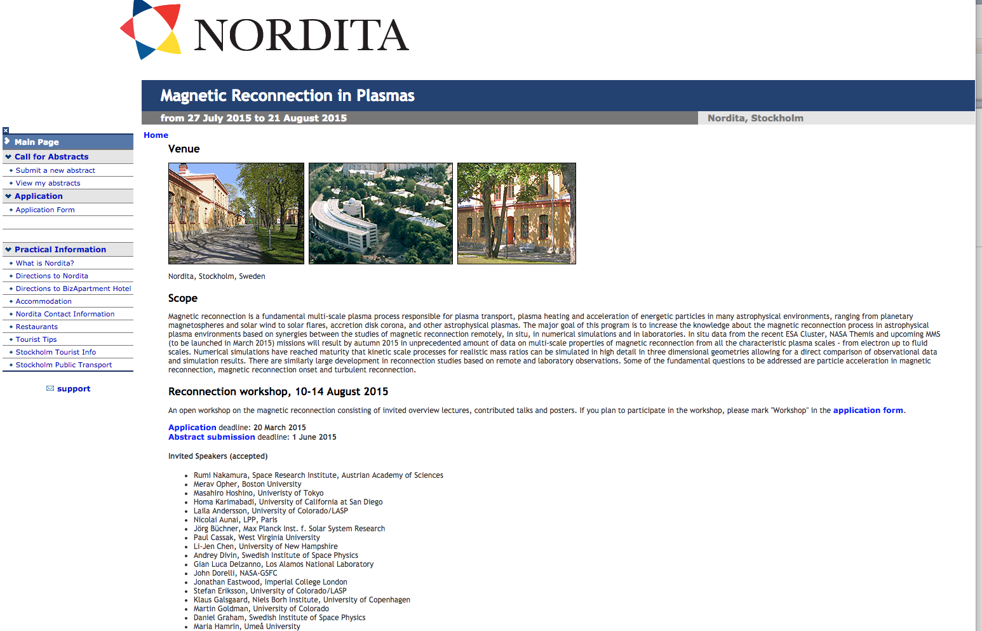
Stockholm workshop
Workshop + School
More information: http://www.nordita.org/mrp2015

Slide 18
FY18: THM/ART-MMS-VAP as shown. P3,4,5 at resonant orbits w/GBOs or w/MMS.
MMS Dayside #3 (THM in Tail) (Feb. 12, 2018) THM on sidereal period resonances, together with GBOs studies Rx fronts, injections, links to VAP; MMS studies drivers
MMS, THM at Dawn or Dusk respectively (dashed: Dec. 2017; solid: May 2018). In both, THM is on MMS-resonant orbits. THM-MMS explore asymmetries of Rx, and drivers of m’pause boundary layer flows.
MMS Tail #3 (THM at dayside) (MMS “extended-tail”, Aug. 29, 2018) THM-MMS on resonant orbits, study dayside-nightside Rx simultaneously.
6
6
ART @55R_{E}
B
P5
P3
A
P4
P5’
P1
P2
MMS
THM
ART @55R_{E}
18
18
THM on sidereal period resonances (8:4:1): T_{P4} = 1 day [P4 R_{A}=12.1R_{E}]
T_{P5} = 8/7 day [P5 R_{A}=13.2R_{E}] T_{P3} = 4/3 day [P3 R_{A}=15.8R_{E}]
Two or three THM-GBO conjunctions (once per 4 or 8 days) explore the dominant energy conversion in the tail and the drivers of nightside reconnection, while MMS captures the global drivers of these phenomena at the dayside. VAP-THM jointly study effects in inner magnetosphere.
THM @ Dawn, Dusk and Dayside is in resonance with MMS Dawn as in FY17. THM @ Dusk and Dayside resonances are: P4,5:MMS = 5:2 [P4,5 R_{A}=13.2R_{E}]
P3:MMS = 2:1 [P3 R_{A}=15.5R_{E}]
Every time MMS is near apogee P3 is too.
Every 2 MMS orbits P4,5 are also at apogee.

Slide 19
FY19 : THM/ART-MMS-VAP as shown. THM at resonant orbits w/ GBOs or MMS.
MMS Dayside #4 (THM in Tail) (Mar. 30, 2019) THM studies dominant energy conversion further out in m’tail, as ART+MMS provide the high-fidelity solar wind and its variations due to foreshock interactions. Near perigee, MMS studies effects of injections.
MMS, THM at Dawn or Dusk respectively (dashed: Jan. 2019; solid: Jul. 2019). As in FY18, but explore asymmetries over a wider swath of m’pause.
MMS Tail #4 (THM at dayside) (MMS “2nd extended-tail”, Sep. 3, 2019) THM-MMS on resonant orbits, study dayside-nightside Rx simultaneously.
6
6
ART @55R_{E}
MMS
MMS’
P5’
P4
P1
P5
P3
P2
THM
ART @55R_{E}
18
18
THM on sidereal period resonances (8:4:1): T_{GBO} = 1 day
T_{P5} = 8/7 day [P5 R_{A}=13.2R_{E}] T_{P3,4} = 4/3 day [P3,4 R_{A}=15.8R_{E}]
Two or three THM-GBO conjunctions (once per 4 or 8 days) explore the dominant energy conversion in the tail and the drivers of nightside reconnection, while MMS captures the global drivers of these phenomena at the dayside.
THM @ Dawn, Dusk and Dayside is in resonance with MMS Dawn is as in FY17. THM @ Dusk and Dayside resonances are: P5:MMS = 5:2 [P5 R_{A}=13.2R_{E}]
P3:MMS = 2:1 [P3 R_{A}=15.5R_{E}]
Every time MMS is near apogee P3 is too.
Every 2 MMS periods P5 is also at apogee. P4 is on same period as P3 at night & dusk but as P5 elsewhere.

Slide 20
FY20: THM clustered at 13.2R_{E} (except at dawn). P3,4,5 at resonant orbits w/MMS.
THM @ Tail (MMS at Dawn) (May. 9, 2020) THM-MMS study the dominant energy conversion in the tail from kinetic scale separations while MMS studies link to inner m’sphere.
MMS, THM both at dawn flank (dashed: Jan. 2020). Evolution of Rx and its relationship to growth of low-latitude boundary layer instabilities, such as Kelvin-Helmholtz.
MMS @ Tail (solid: Sep. 8, 2020). THM is an MMS-resonant string-of-pearls studying connections to both m’pause and inner m’sphere.
6
ART @55R_{E}
MMS’
MMS
P1
THM’
P2
THM
ART @55R_{E}
18
THM – MMS on resonant orbits (5:2): P5:MMS = 5:2 [P5 R_{A}=13.2R_{E}]
Every 2 MMS periods, when MMS passes through its in- or out-bound leg, THM is near apogee or inbound leg.
From its kinetic-scale separations THM explores the dissipation of flow and magnetic energy in the tail while MMS captures their effects in the inner magnetosphere.
THM-MMS@Dawn resonances with MMS are as in FY19 (5:2 for P4,5 and 2:1 for P3). MMS @ Tail resonances are as in FY20 THM@tail (5:2 for all P3,4,5). Once every other MMS orbit, MMS is at Rx point and THM is at m’pause to capture day/night connections. The other MMS orbit THM is at in-bound leg (string of pearls) studying link of Rx/injections to inner magnetosphere over a wide range of L-shells

